Slide 1
Time-Cost Trade-Off (Time Reduction = Time Compression = Time Shortening)

Slide 2
Why Project Time Reduction
To meet the customer contractually required time.
To recover time of delays, that occur in the early stages of the project, to avoid paying liquidated damages, or avoid damaging the company relationship with the customer.
To complete a project early, free key resources and move on to another project.
To avoid adverse weather.
To receive an early-completion bonus. (By the Contract)
To realize incentive pay. (catch a business season)
To meet a client’s desire for expediting the project.

Slide 3
How to Shorten Project Time
Free Time
Reviewing the job logic (critical activities in parallel).
Reviewing duration of critical activities.
Use overlap.
Use subcontractor.

Slide 4
How to Shorten Project Time
Buy Time
Have the existing crew work overtime.
Bring in additional workers (resources) up to practical limit.
Work on multiple shifts.
Achieve more output by offering incentive payments.
Use better/more advanced equipment.
Use more quickly installed materials.
Use subcontractors.
Change construction method.

Slide 5
Purpose of Time Reduction Technique
The main purpose of this topic is to demonstrate a procedure to determine activity schedules to reduce the project duration time with a minimum increase in the project direct costs, by buying time along the critical path (s) where it can be obtained at least cost.

Slide 6
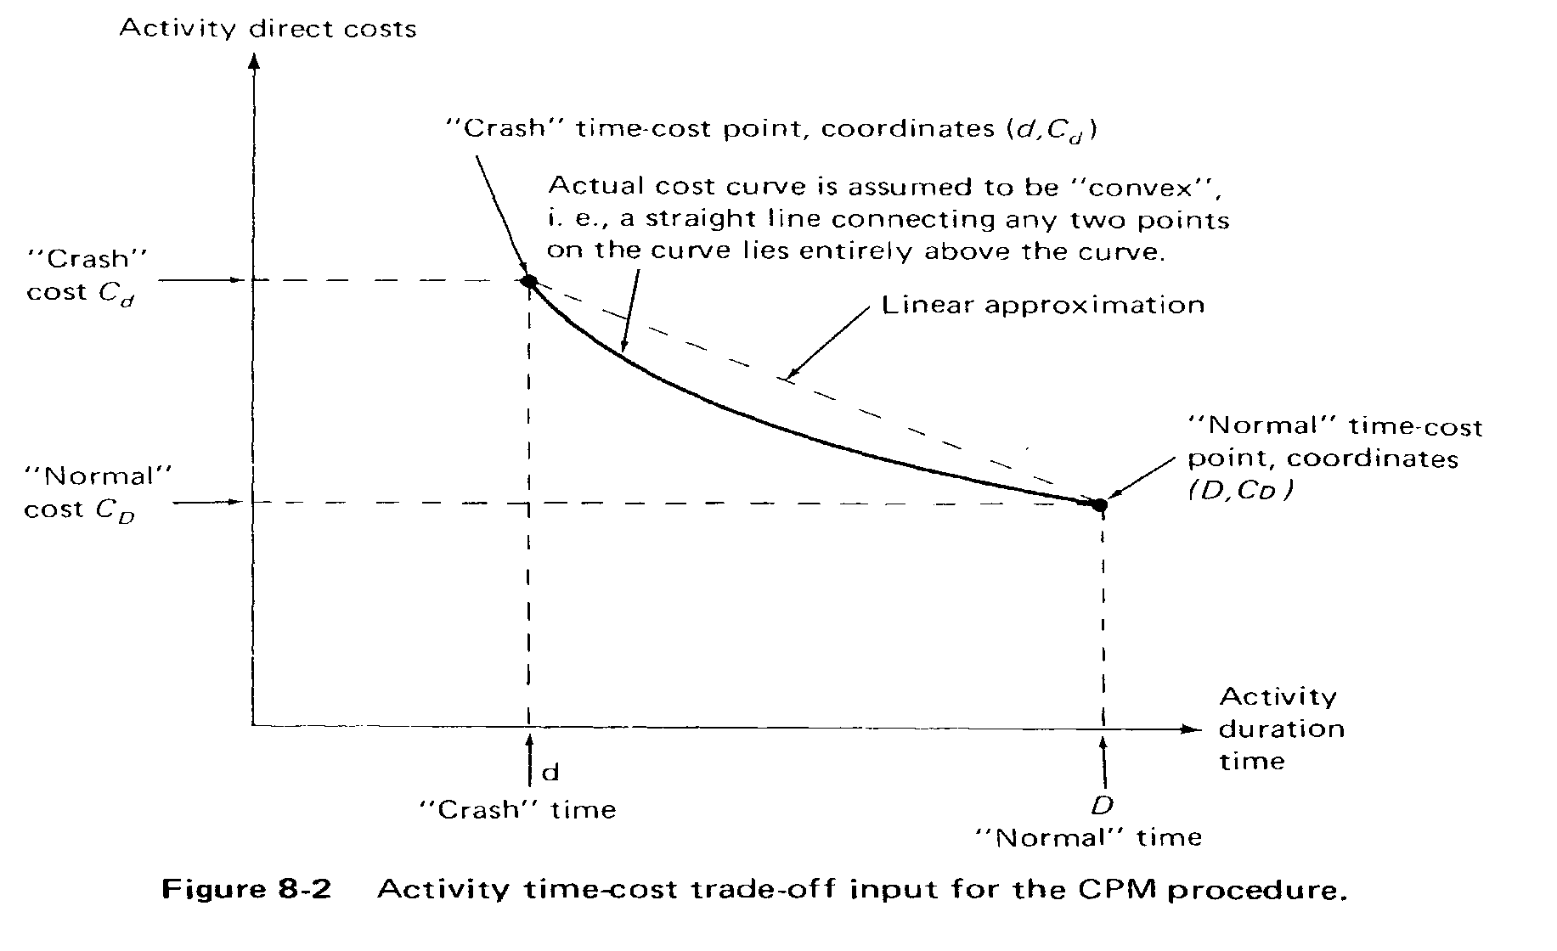
Definitions
Activity time-cost trade-off input for the CPM procedure

Slide 7
Definitions
Activity Direct Costs: include the cost of the material, equipment, and direct labor required to perform the activity in question. If the activity is being performed in its entirety by a subcontract, plus any fee that may be added.
Project indirect costs: may include, supervision and other customary overhead costs, the interest charges on the cumulative project investment, penalty costs for completing the project after a specified date, and bonuses for early project completion.

Slide 8
Definitions
Normal Activity Time-cost Point
Normal Activity Time (D): It is the normal time that is used in the basic critical path planning and scheduling based on the normal level of resource.
Normal Activity Cost (C_{D}): The normal activity cost is equal to the minimum of direct costs required to perform the activity, and the corresponding activity duration is called the normal time.
The normal time is actually the shortest time required to perform the activity under the minimum direct cost constraint.

Slide 9
Definitions
Crash Activity Time-cost Point
Crash Activity Time (d): is fully expedited or minimum activity duration time that is technically possible.
Crash Cost (C_{d}): is assumed to be the minimum direct cost required to achieve the crash performance time.

Slide 10
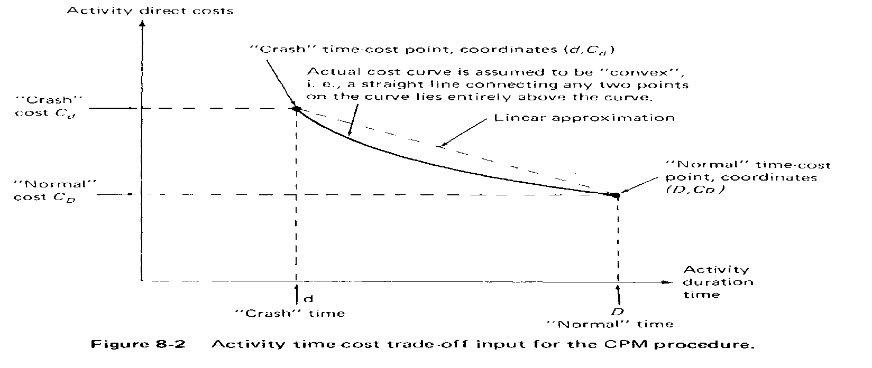
Activity Direct Cost / Time Relationship
The relationship between the activity direct cost and activity time may be straight line, continuous curve, discrete values, or point.
The direct cost tends to increase if less time is available for activity.
Time reduction approach (learned here) will be based on simple linear time-cost trade-off curves for each activity
Activity time-cost trade-off input for the CPM procedure

Slide 11
Equations
Cost slope (C_{ij}) = Crash cost (C_{d}) - Normal cost(C_{D}) .
Normal duration (D)- Crash duration(d)
Time Available (TA_{ij}) = [Normal duration (D ) - Crash duration(d)]_{ij}
Effective Cost Slope (EC_{ij}) = Cost slope (C_{ij}) .
Number of inadequately shortened paths (N_{ij})

Slide 12
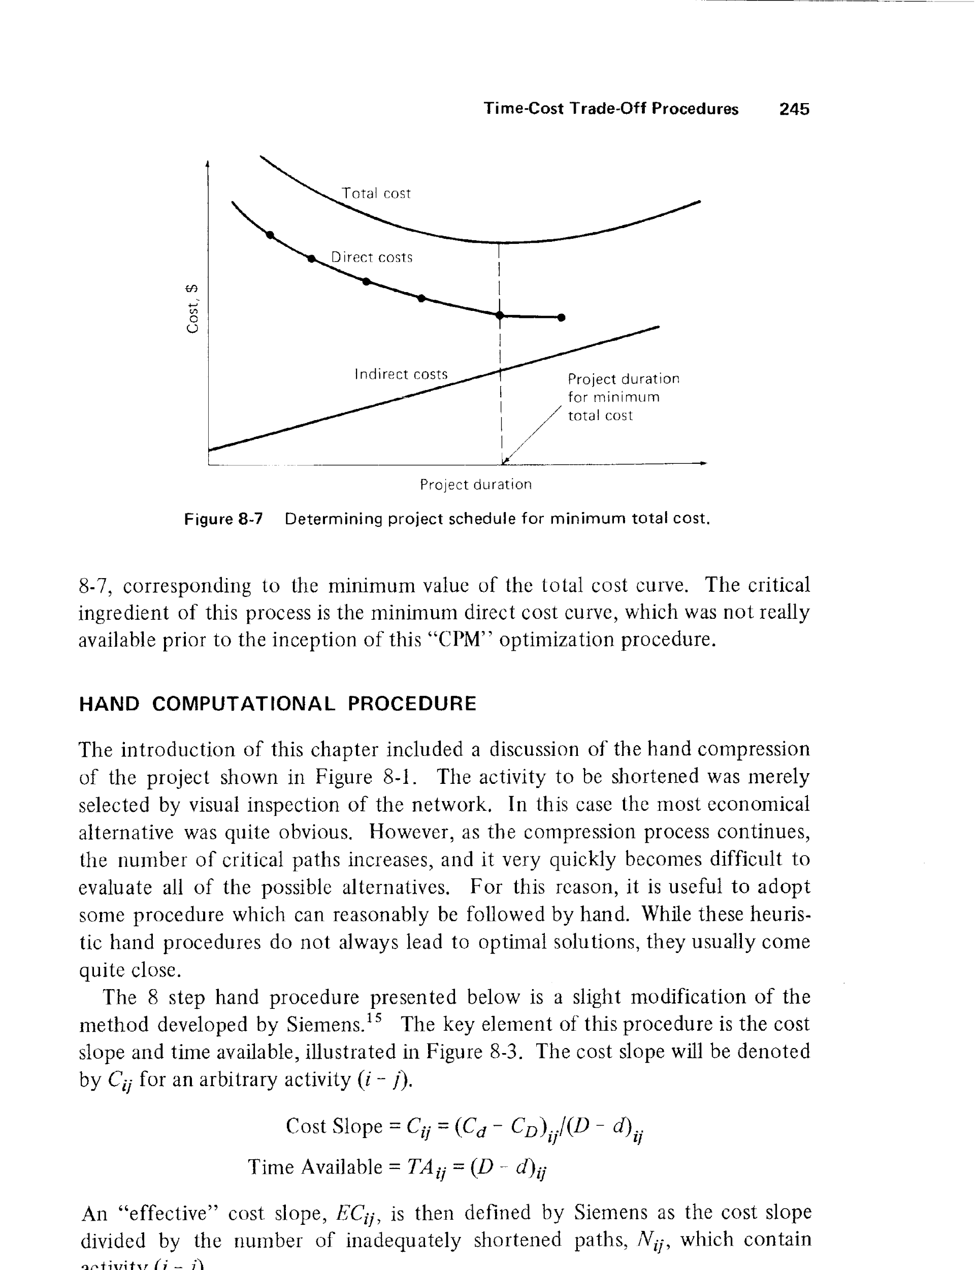
Indirect Cost / Time Relationship
The indirect cost tends to increase if more time is consumed for the project. The indirect cost is generally vary approximately linearly with the time.

Slide 13
Optimum Contract Duration
Optimum contract duration = project schedule for minimum total cost
Determining project schedule for minimum total cost

Slide 14
Procedure for Shortening Project Time
Prepare the project Network and time estimates, and list in columns all paths through the network whose expected lengths are greater than the desired (schedule) project duration, T_{s}. The length of a path in question. Also, note at the bottom of each path column (row marked iteration 0), the time reduction that is required, i.e. expected path length minus T_{s}.
List (in row) all activities present in at least one of the listed paths noting for each activity its cost slope, C_{ij} , and time reduction available, TA_{ij}.
Compute the effective cost slopes, EC_{ij}, and record them in the column headed iteration 1.

Slide 15
Procedure for Shortening Project Time
For the path(s) with the most remaining time reduction required, select the activity with the lowest effective cost slope. Break ties by considering the following ordered list:
Give preference to the activity which lies on the greatest number of inadequately shortened paths.
Give preference to the activity which permits the greatest amount of shortening.
Choose an activity at random.
Shorten the selected activity (i-j) as much as possible, which will be equal to the minimum of the following:
The unallocated time remaining for the selected activity (i-j), or
The smallest demand of those inadequately shortened paths containing the activity (i-j).

Slide 16
Procedure for Shortening Project Time
Sell back, or deshorten, as much time possible on paths that have been overcut, as long as this action does not cause any new paths to become inadequately shortened.
Stop of all paths have been adequately shortened. If not, recalculate those effective cost-slopes where any of the following have occurred:
A path which was inadequately shortened prior to this iteration, has been adequately shortened, or
All unallocated time for the activity just shortened has been consumed and there are one or more additional cost-slope/supply pairs for this activity.
Return to Step 4.

Slide 17
Example
The below network shows the activities of a small engineering project. Data of the project is given in the below table. The indirect cost is estimated to be SR100/day. Draw the contract total cost/time curve and determine the optimum contract duration.
Activity code | Time (day) |  | Cost (SR)
 | normal | crash | normal | Crash
A | 4 | 3 | 210 | 280
B | 8 | 6 | 400 | 560
C | 6 | 4 | 500 | 600
D | 9 | 7 | 540 | 600
E | 4 | 1 | 500 | 1,100
F | 5 | 4 | 150 | 240
G | 3 | 3 | 150 | 150
H | 7 | 6 | 600 | 750

Slide 18
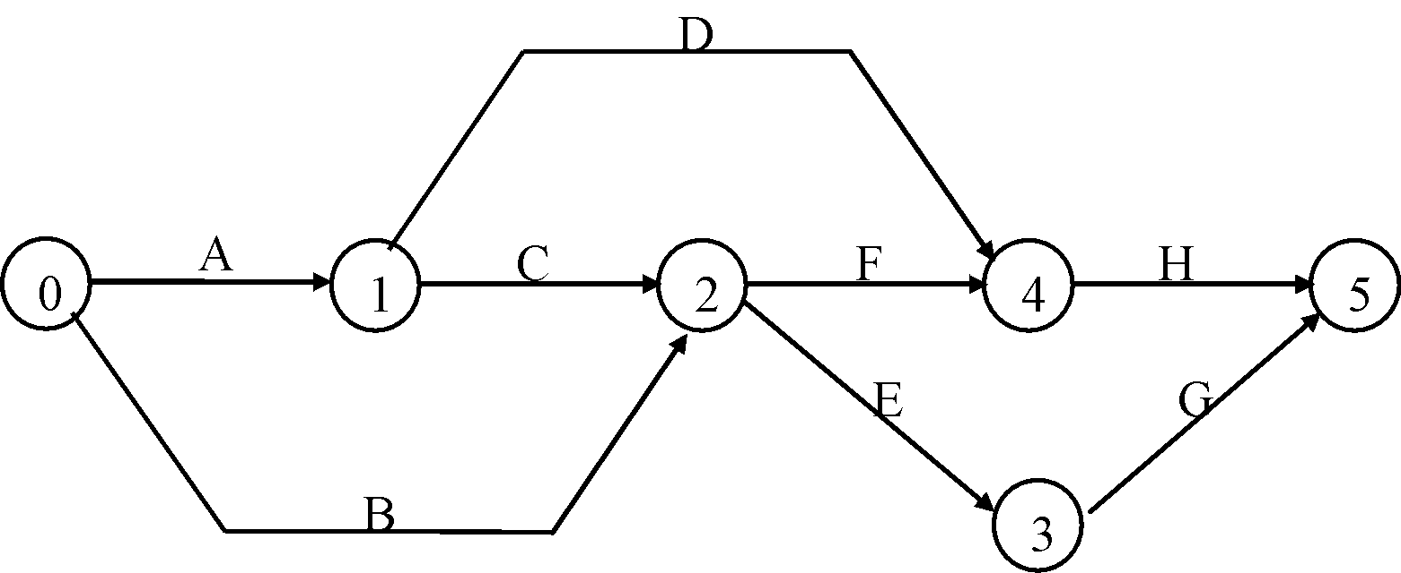
Example
Project Network

Slide 19
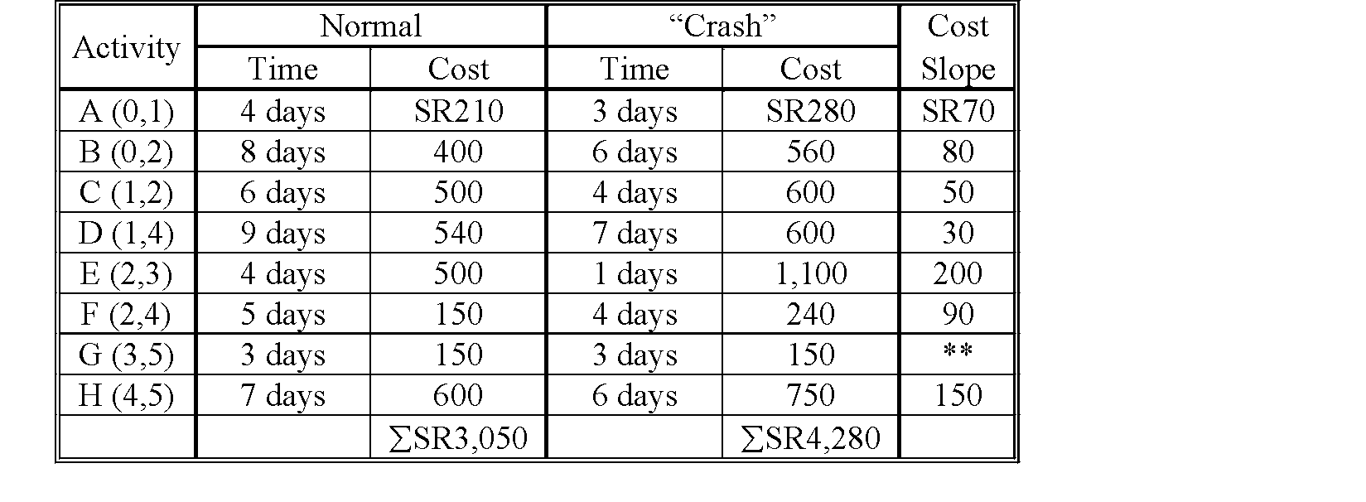
Example
** This Activity can not be expected.

Slide 20
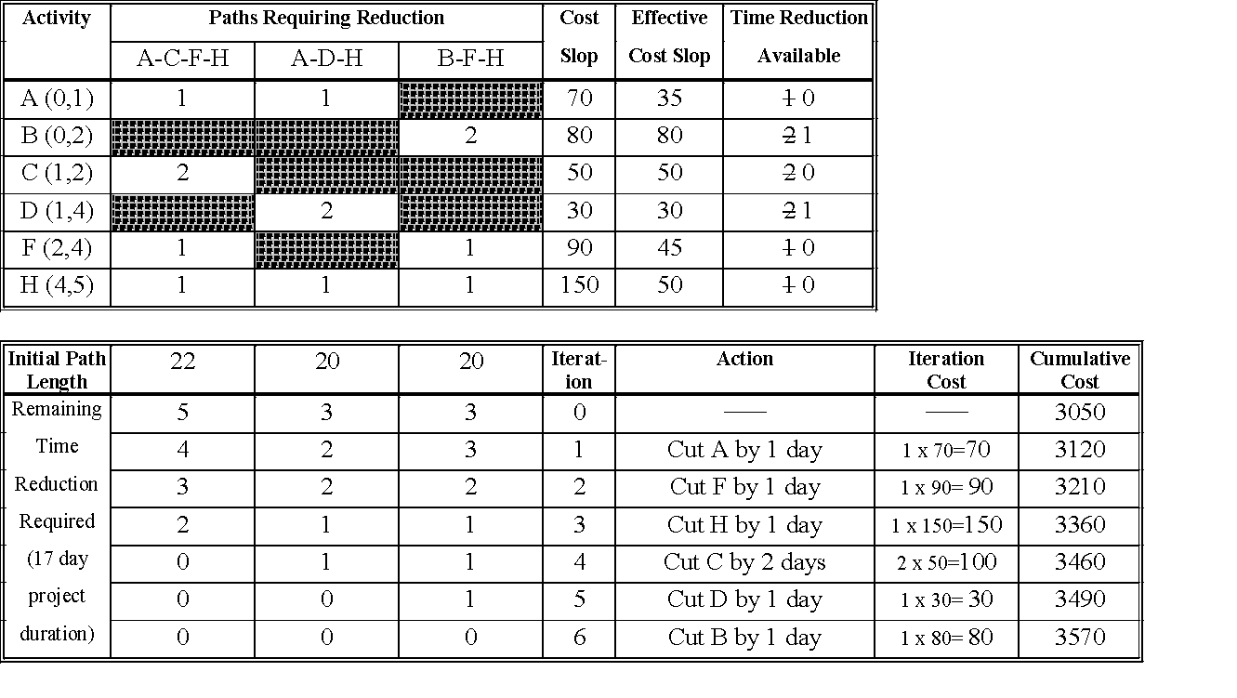
Reduction project time from 22 to 17 day

Slide 21
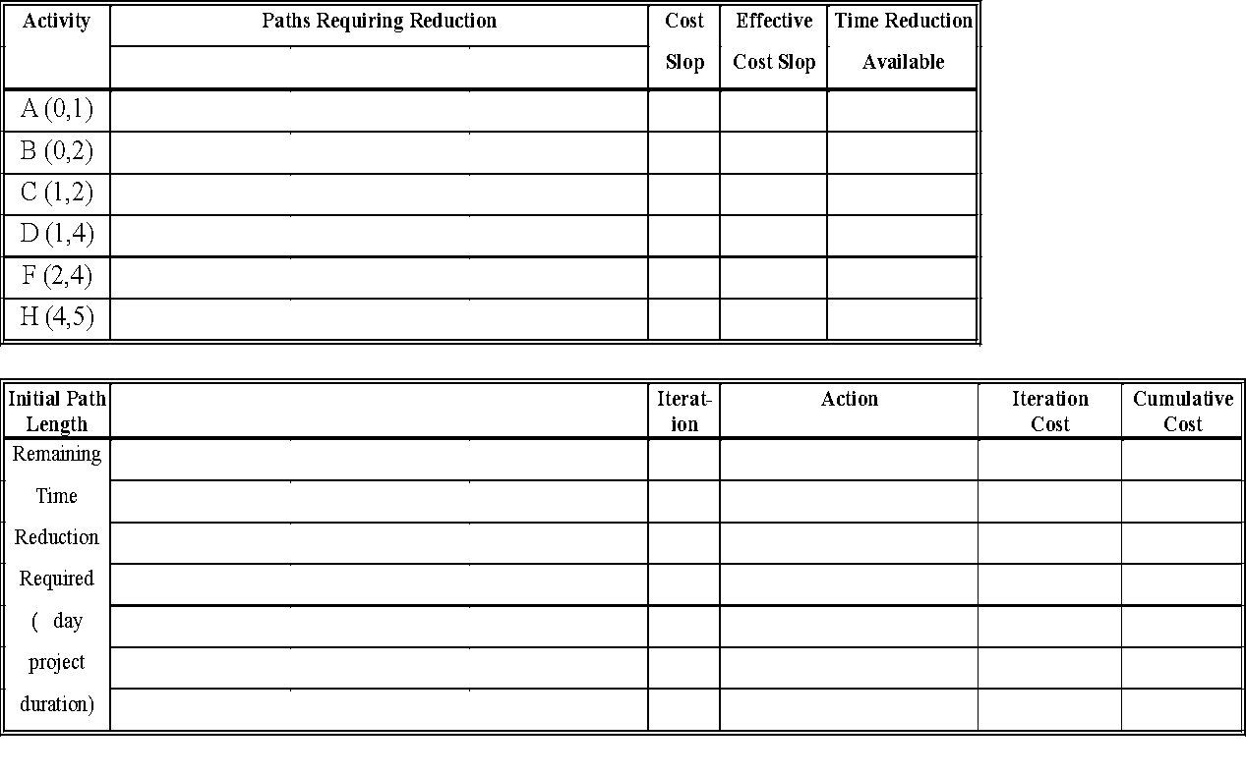
Reduction project time from 22 to

Slide 22
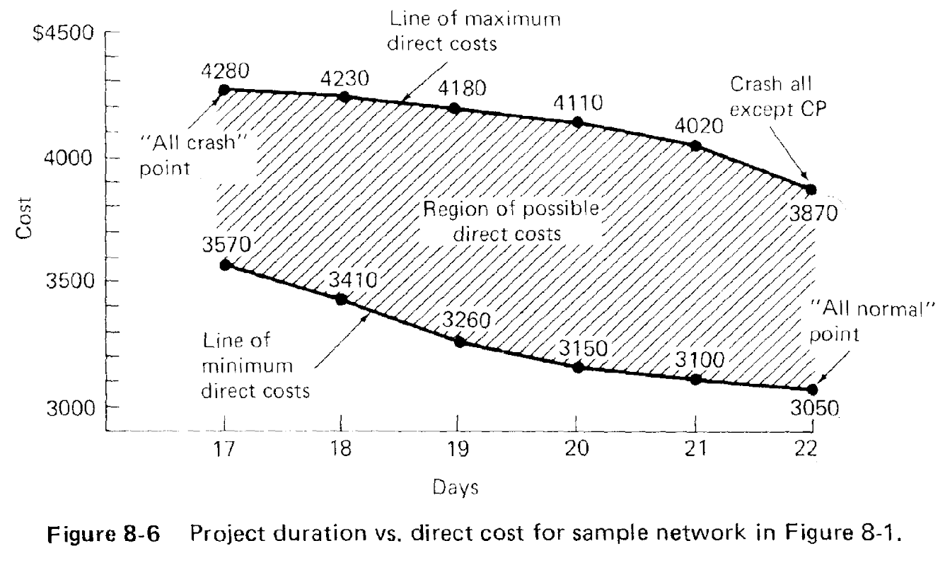
Accelerating the Critical and Noncritical path

Slide 23
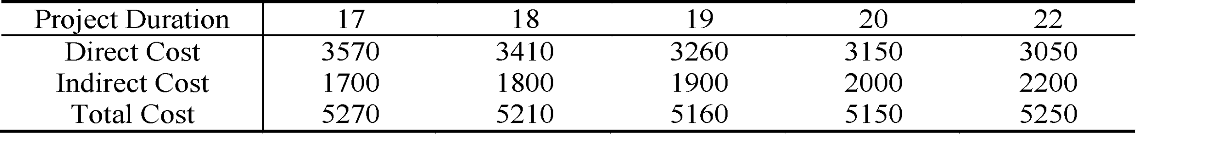
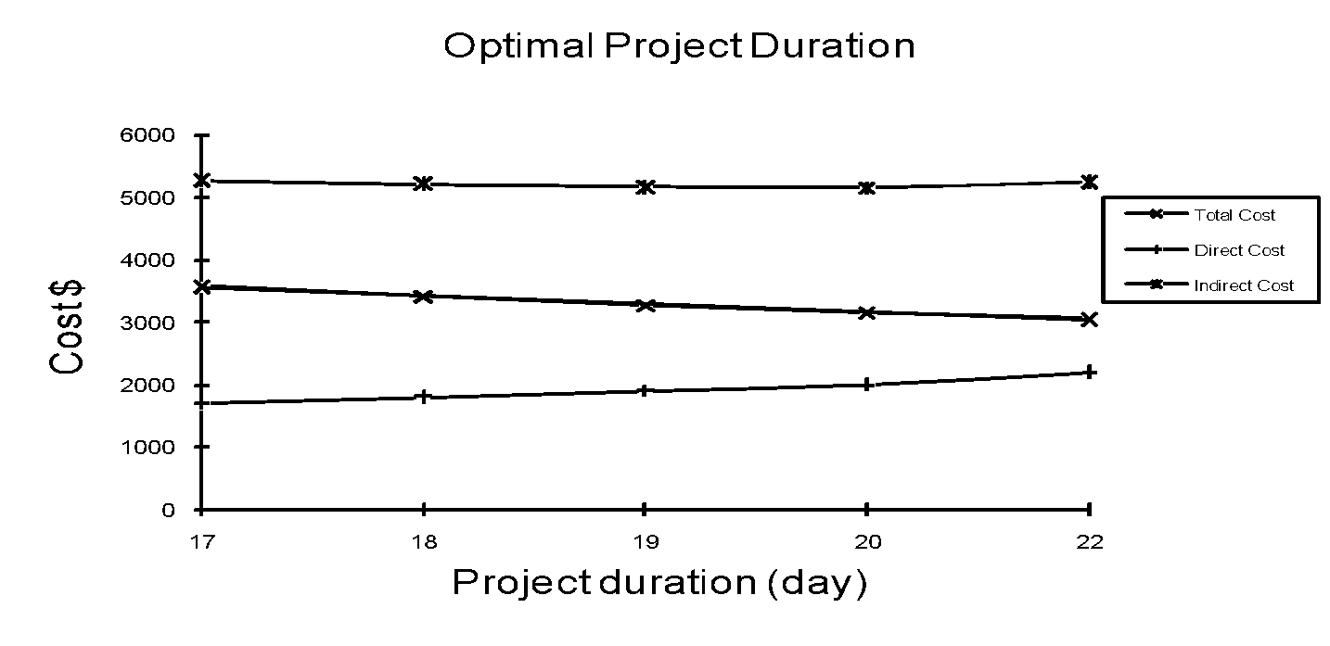
Optimal Project Duration

Slide 24
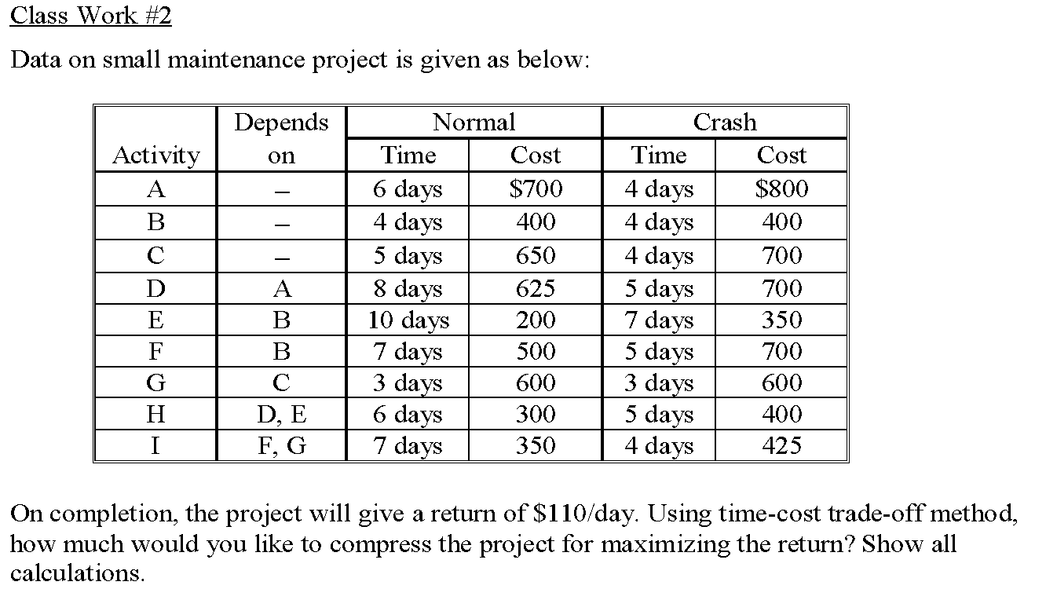
Class work

